Slide 1
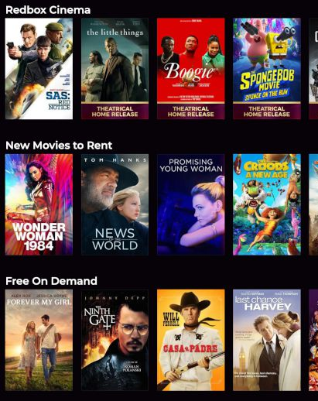
Rockbuster Stealth’s Analysis
Prepared by Antonina Masko
Notes:
To change the image on this slide, select the picture and delete it. Then click the Pictures icon in the placeholder to insert your own image.

Slide 2
List of content
Introduction
Summary statistics and analysis
Conclusions and Recommendation
Appendix

Slide 3
Introduction

Slide 4
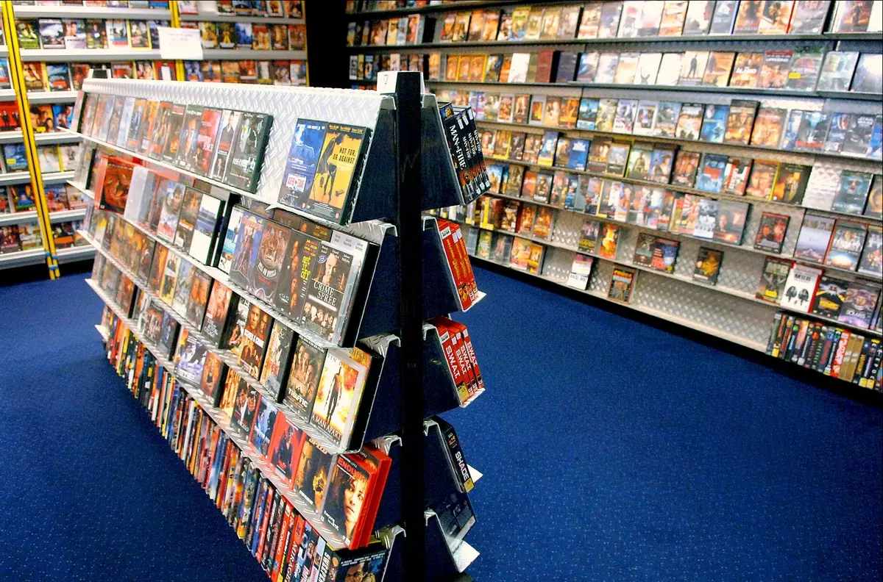
Introduction
Rockbuster Stealth LLC is a movie rental company that used to have stores around the world. Facing stiff competition from streaming services such as Netflix and Amazon Prime, the Rockbuster Stealth management team is planning to use its existing movie licenses to launch an online video rental service in order to stay competitive.

Slide 5
Key Questions and Objectives
Which movies contributed the most/least to revenue gain?
What was the average rental duration for all videos?
Which countries are Rockbuster customers based in?
Where are customers with a high lifetime value based?
Do sales figures vary between geographic regions?

Slide 6
Summary statistics and analysis

Slide 7
Which movies contributed the most/least to revenue gain?

Slide 8
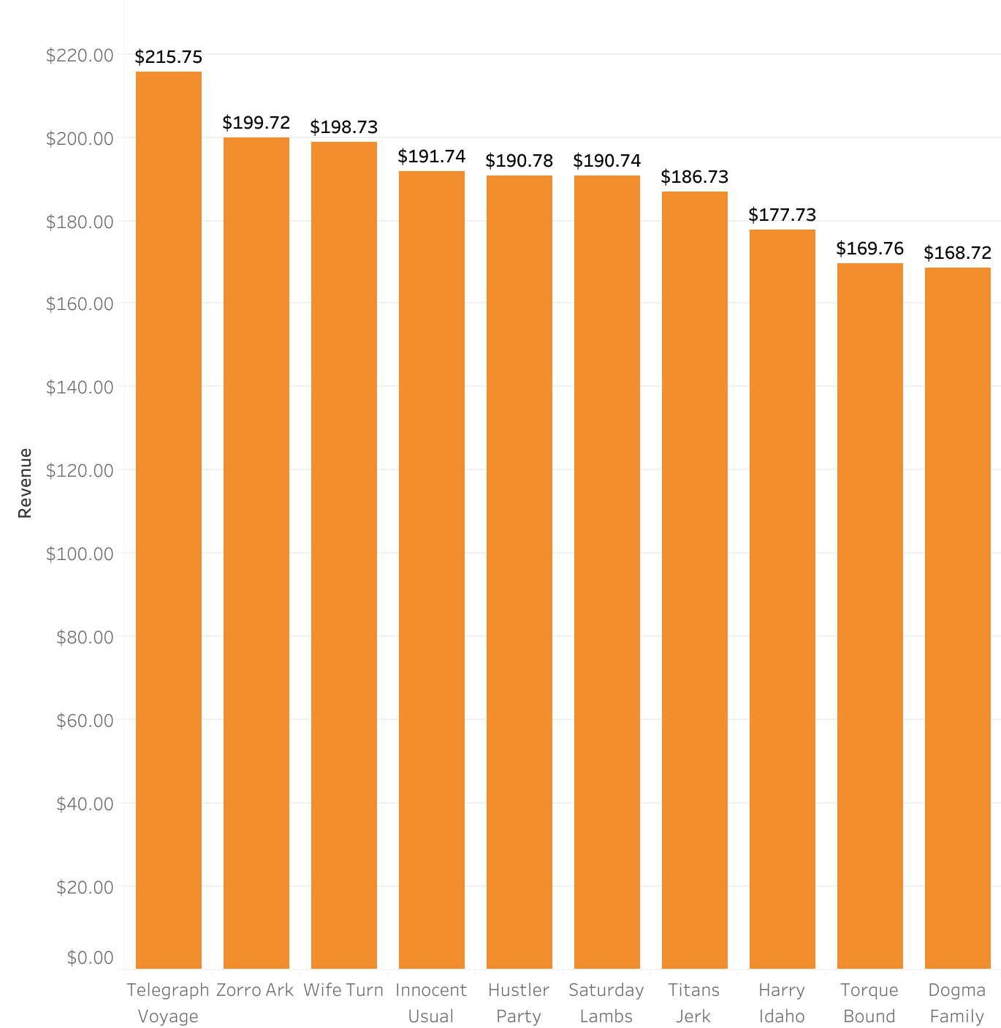
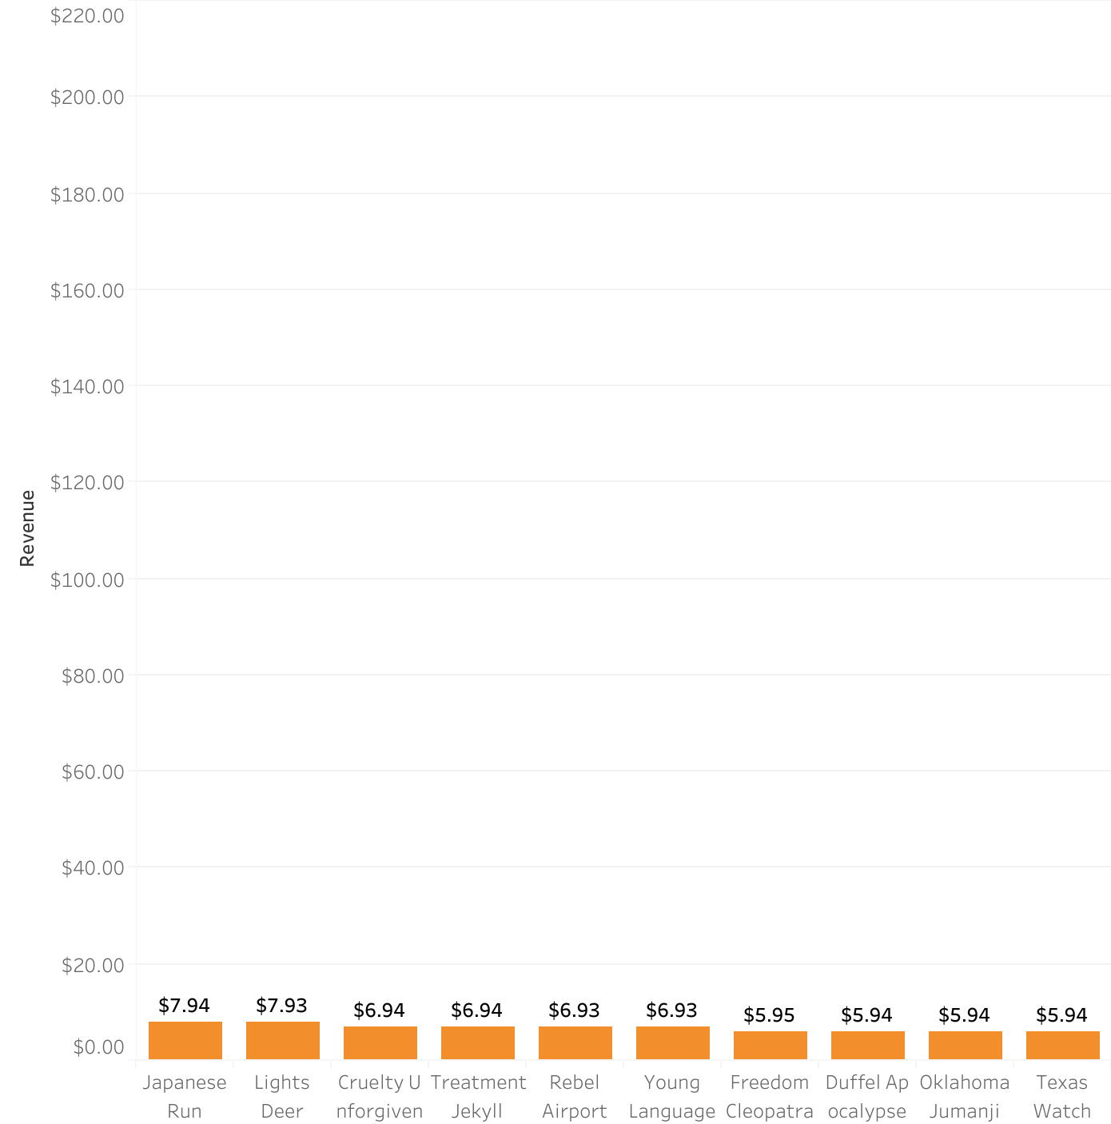
Top and bottom 10 grossing movies
Top 10 movies
Bottom 10 movies

Slide 9
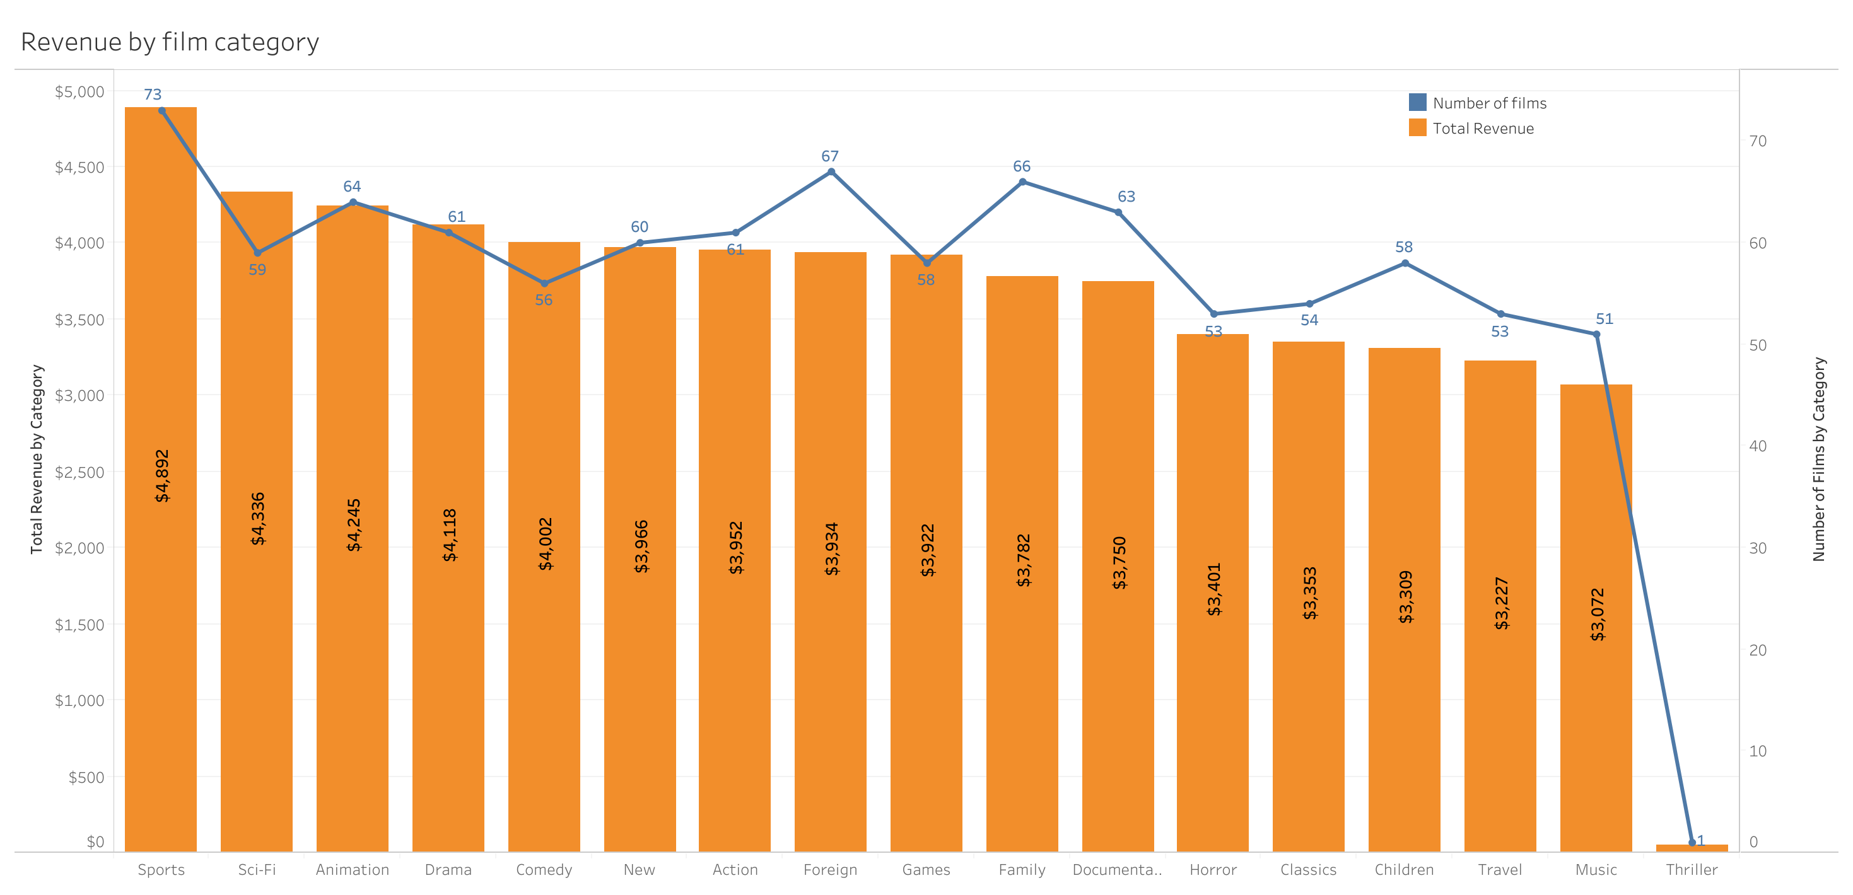
Total Revenue by Film Category
The film categories with the highest revenue are:
Sports
Sci-Fi
Animation
Drama
Comedy
The least profitable film genre is Thriller, however Rockbuster owns only one film in this category.

Slide 10
What was the average rental duration for all videos?

Slide 11
Film and Customer – Descriptive Statistics
Film statistics | Minimum | Average | Maximum
Rental Duration | 3 days | 4.9 days | 7 days
Rental Rate | $0.99 | $2.98 | $4.99
Replacement Cost | $9.99 | $19.98 | $29.99
Film length | 46 min | 115.3 min | 185 min
Film statistics | Value
Number of films | 1000
Release year (mode) | 2006
MMPA Rating (mode) | PG-13
Customer statistics | Value
Number of customers | 599
Number of stores | 2

Slide 12
Which countries are Rockbuster customers based in?

Slide 13
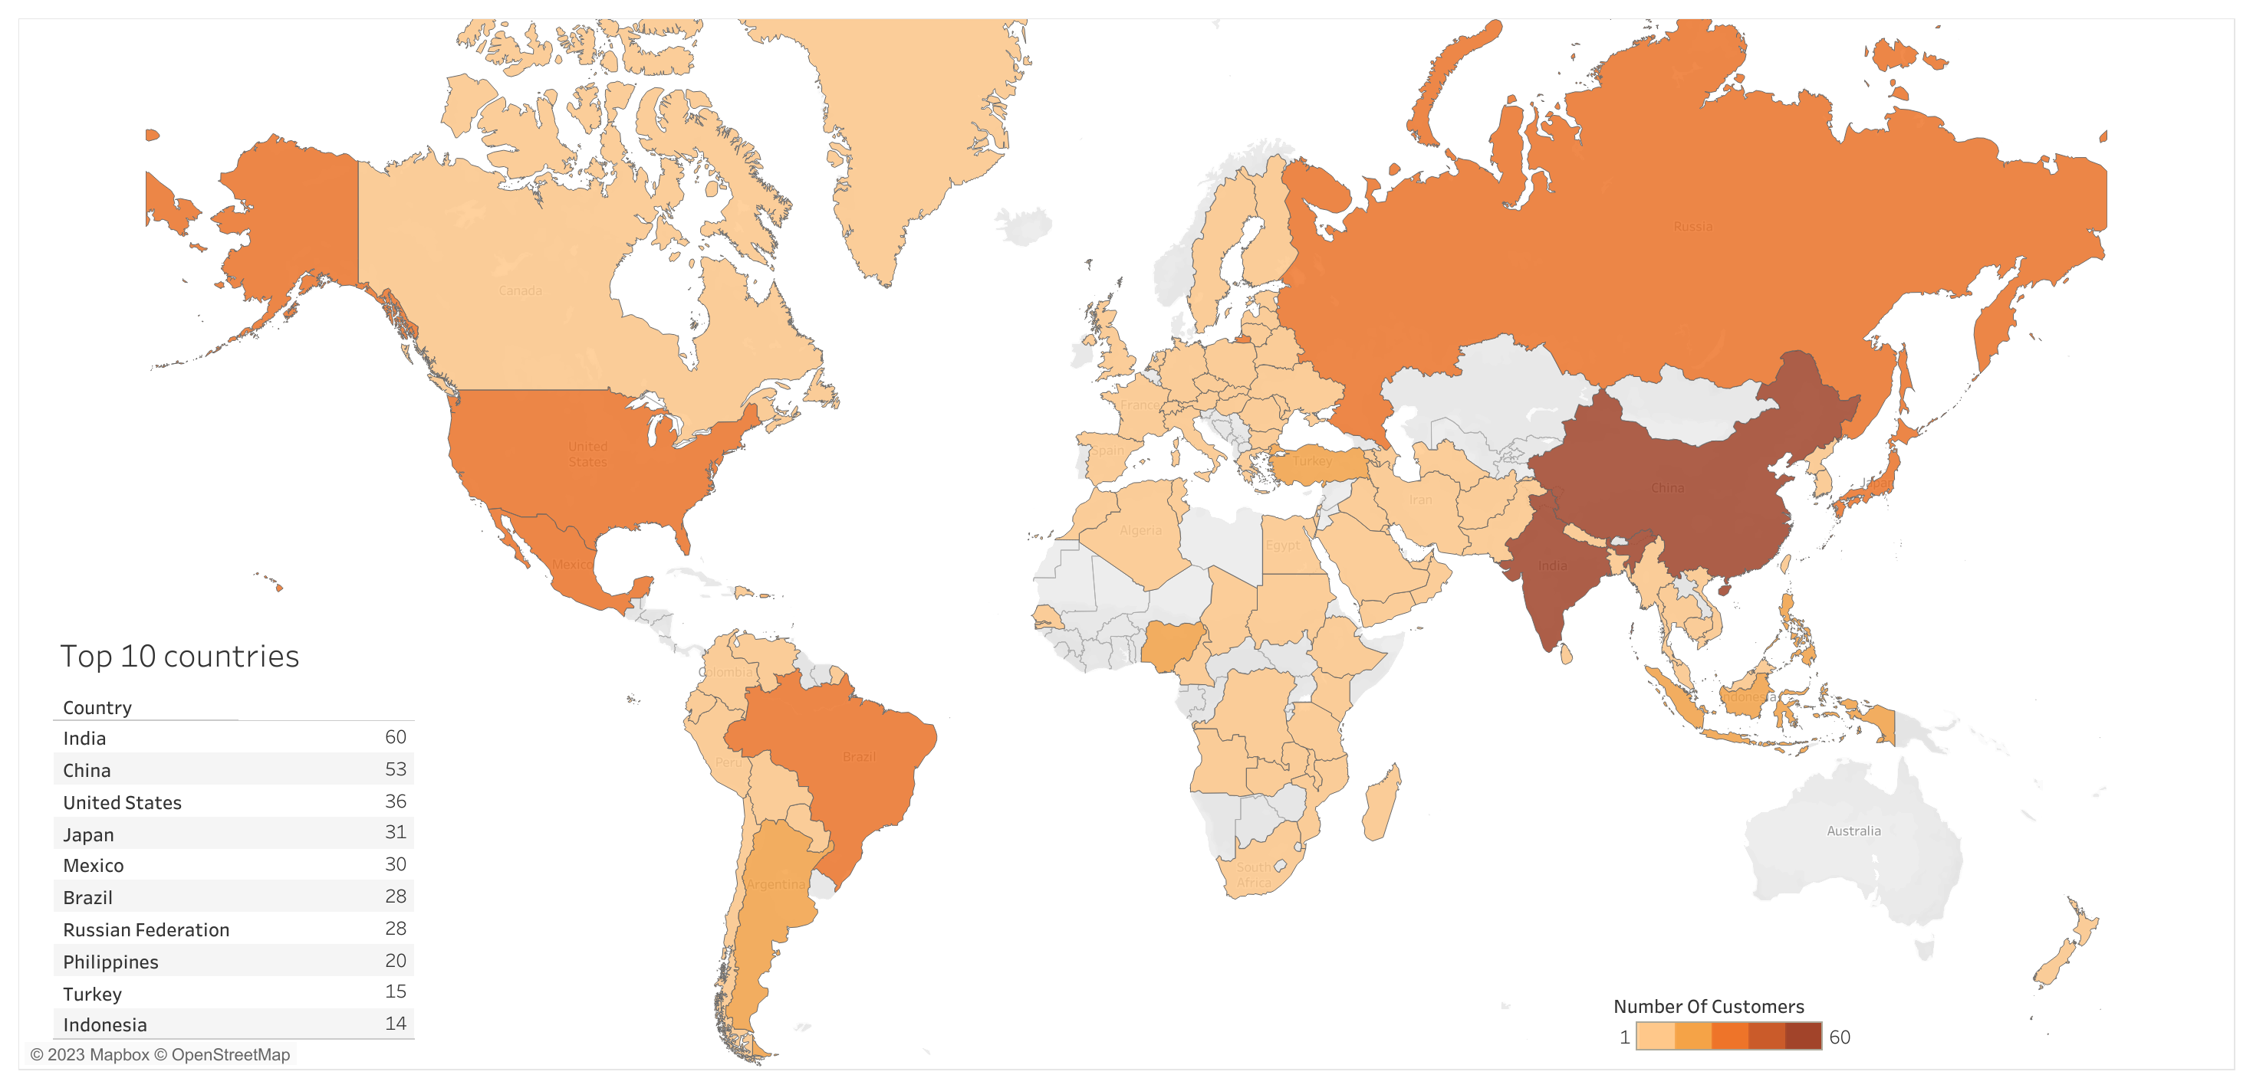
Countries by number of customers

Slide 14
Where are customers with a high lifetime value based?

Slide 15
Top 10 customers (by sales amount)
Last Name | First Name | Customer ID | Country | City | Total revenue (USD)
Hunt | Eleanor | 148 | Reunion | Saint-Denis | 211.55
Seal | Karl | 526 | United States | Cape Coral | 208.58
Snyder | Marion | 178 | Brazil | Santa Barbara dOeste | 194.61
Kennedy | Rhoda | 137 | Netherlands | Apeldoorn | 191.62
Shaw | Clara | 144 | Belarus | Molodetno | 189.60
Collazo | Tommy | 459 | Iran | Qomsheh | 183.63
Bradley | Ana | 181 | United States | Memphis | 167.67
Irby | Curtis | 410 | Canada | Richmond Hill | 167.62
Dean | Marcia | 236 | Philippines | Tanza | 166.61
Way | Mike | 403 | India | Valparai | 162.67
Class | Group A | Group B
Class 1 | 82 | 95
Class 2 | 76 | 88
Class 3 | 84 | 90

Slide 16
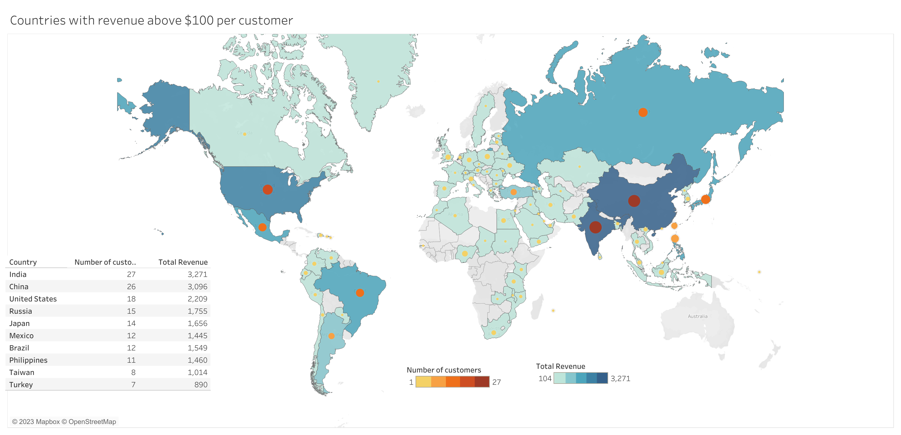
Countries with revenue above $100 per customer

Slide 17
Do sales figures vary between geographic regions?

Slide 18

Total Revenue by Continent
45.6% of all sales come from Asia region, with Europe being second (18.0%), followed by North (13.3%) and South Americas (11.7%).
Oceania
614
South America
7’141
Africa
6’342
North America
8’173
Asia
27’949
Europe
11’065
All amounts in USD

Slide 19
Conclusions and Recommendations

Slide 20
Conclusions and Recommendation
Rockbuster has currently only 1000 movies in their collection
To be competitive, Rockbuster should increase the number of titles available and include newer movies (the total collection is from 2006)
Most profitable regions are Asia and Europe
Rockbuster should focus on the countries with highest revenue per customer, i.e.: India, China, United States, Russia and Japan. Later, they can expand to other countries of Asia and South America
Rockbuster has three rental prices for the movies: $0.99, $2.99 and $4.99
Rockbuster should consider changing their pricing method and implement monthly access with different payment plans instead of pay-per-view
Top 10 customers of Rockbuster are very loyal
Rockbuster should award their loyalty by e.g. offering them a 3-month free access to the movie library

Slide 21
Appendix

Slide 22
Links to Tableau visualizations
Top 10 movies (slide 8)
Bottom 10 movies (slide 8)
Revenue by film category (slide 9)
Countries by number of customers (slide 13)
Top 10 customers (slide 15)
Countries with revenue above $100 per customer (slide 16)
Total revenue by Continent (slide 18)

Slide 23

THANK YOU
In case of questions, please send an email at:
antonina.masko@gmail.com

